Slide 1
Tech gist of the week Scopes and closures
Daniel Marchena

Slide 2
Lexical scope
This usage of the word describes the regions in your source code, where you can refer to a variable by name without getting access errors.
You can understand the specific rules of this version of scoping even without running your code.

Slide 3
TIME TO CHECK SOME CODE!!!

Slide 4
In-memory scope / Execution contexts
Execution contexts or in memory scopes differ from lexical scopes. In that, they are build as the code runs, not as it`s typed.
The rules govern which variables a program has access to at different points during the execution.
As the program runs, it will be building up internal data stores for keeping track of all the variables that are available to different function objects.

Slide 5
WAKE UP, TIME TO CODE!!!

Slide 6
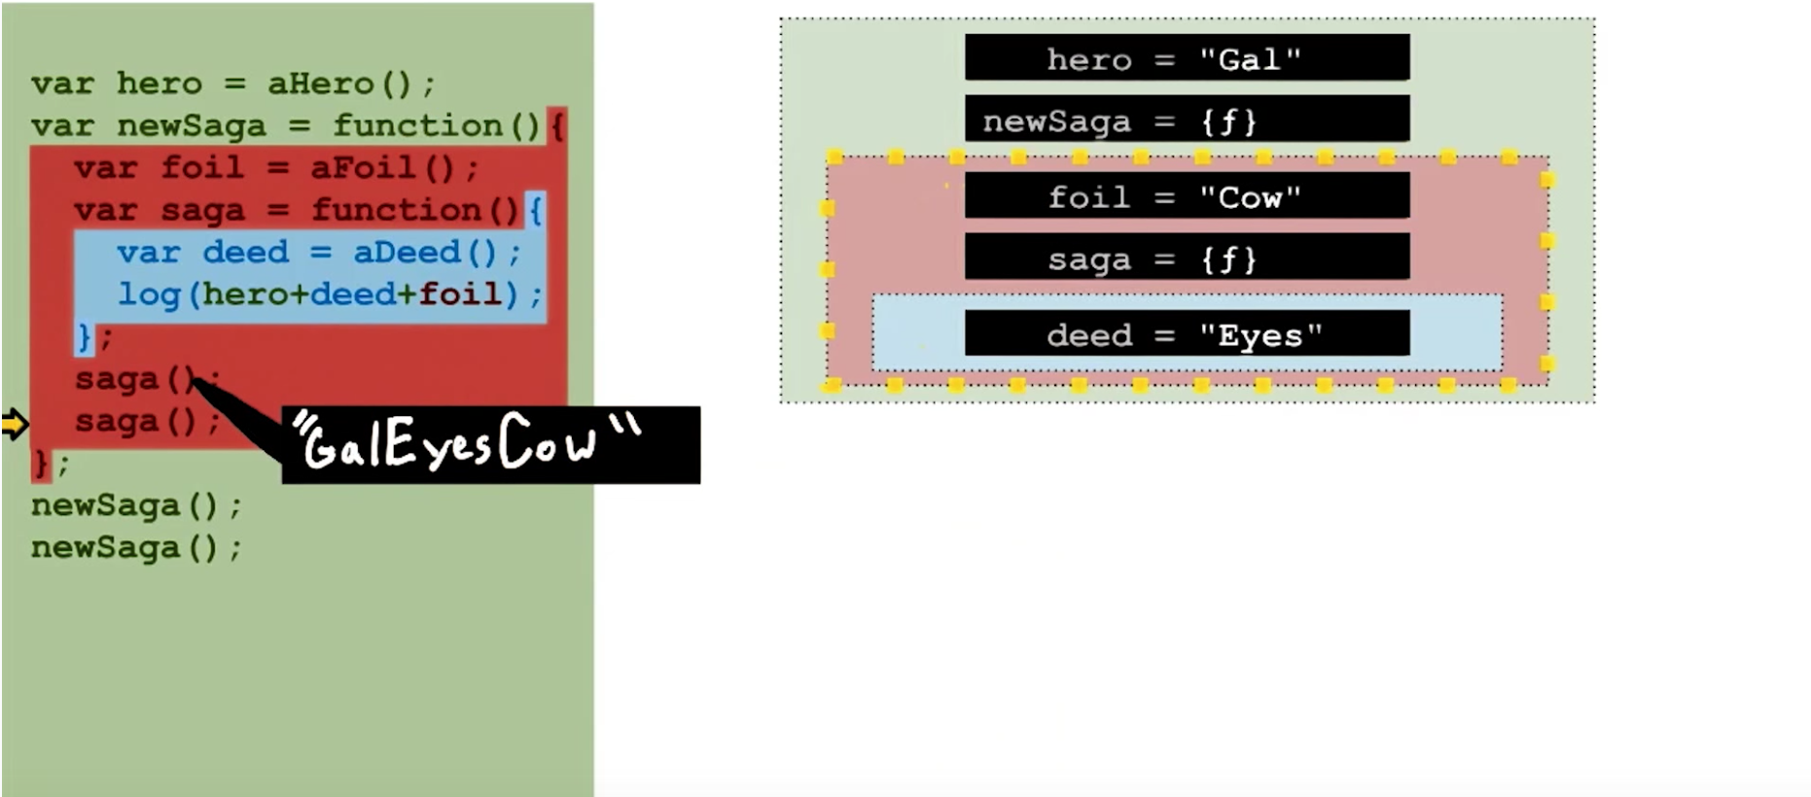

Slide 7
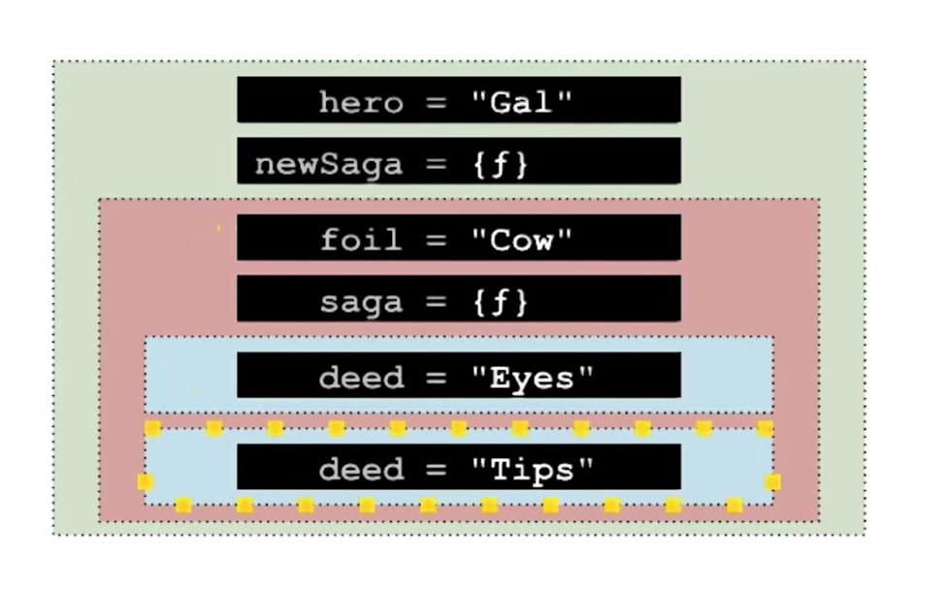

Slide 8
Closures
Put simply, every function should have access to all the variables from all the scopes that surround it.
A closure is just any function that somehow remains available after those outer scopes have returned. (what the hell?)

Slide 9
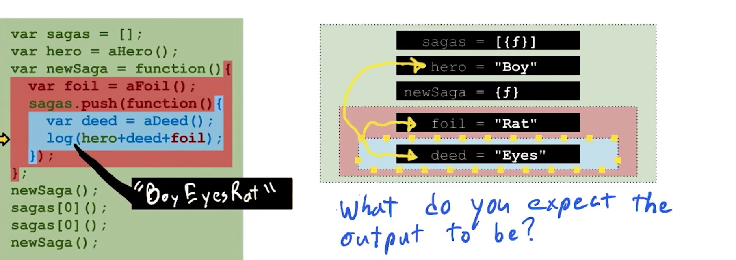
That remembers you of array of promises?

Slide 10
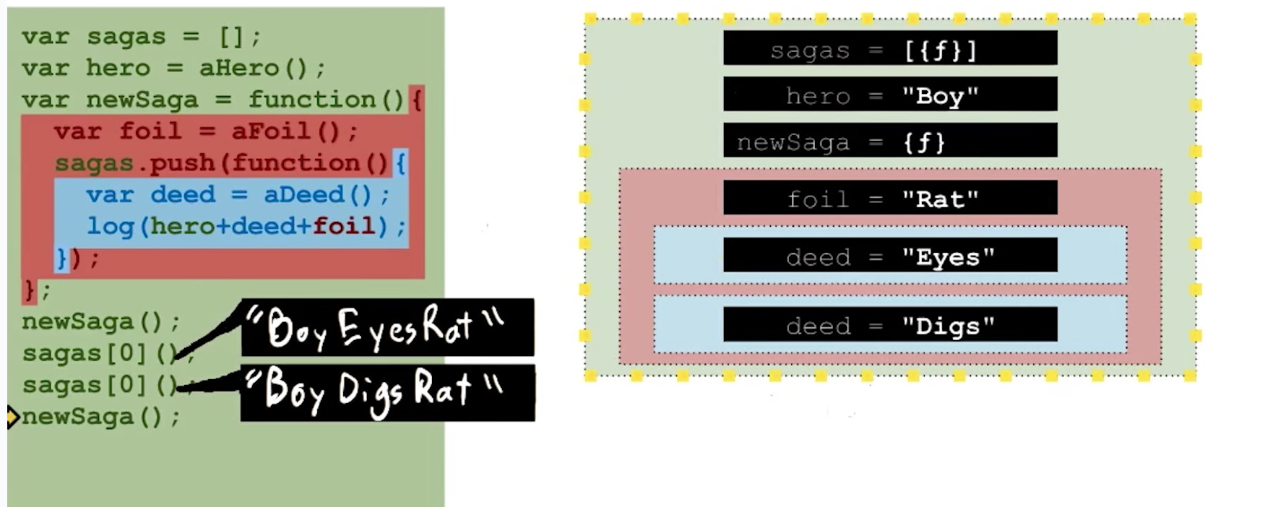

Slide 11
